Slide 1
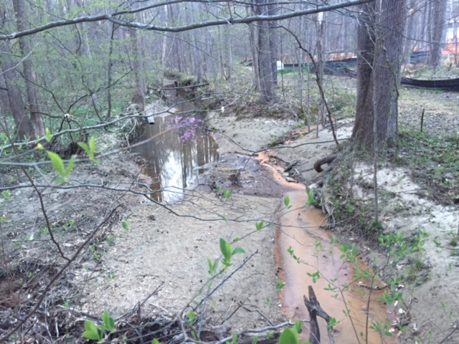
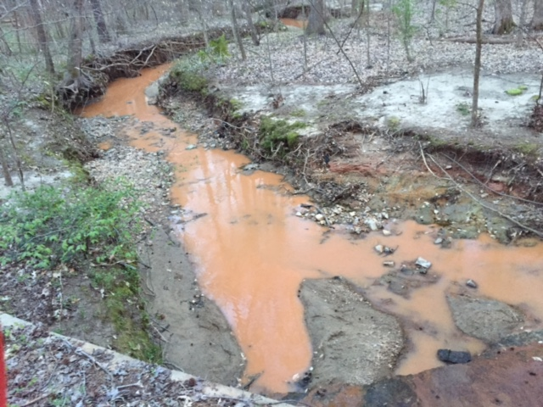
4 April 2016 To: Raleigh Stormwater Inspections Section From: Springdale Estates Lake Committee Re: Possible Illicit Discharge in Hare Snipe Creek from Duckview Court on 24 March 2016 Dear Raleigh Stormwater Inspection Service: Several of the residents of Springdale Estates noted a large discharge of muddy water into Hare Snipe Creek from Duckview Court on 24 March 2016. Figures 1 and 2 show the impact on the Creek; note that all of this mud-laden water came from the dumping as it had not rained that day. Figure 3 shows the site of the discharge including the tracks left by the trucks. The water came from trucks of the Vacall company (Figure 4) and purportedly the source of the water was a stormwater retention device in Baybridge Wynd. Unfortunately at the time of this dumping there was one or more gaps (Figure 5) in the silt fence between where the water was dumped and the Hare Snipe allowing the water a direct path(s) into the Creek carrying suspended soil, etc. After this discharge into the Creek the gap(s) in the silt fence were rectified but the damage was already done. Sincerely, Van Cotter for The Springdale Estates Lake Committee
Figures 1 (Upstream) and 2 (Downstream). 24 March 2016 7:23 pm
Impact on Hare Snipe Creek of water dumping. Note clear water above location where dumped water entered Creek.

Slide 2
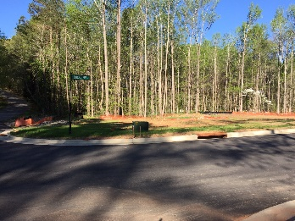
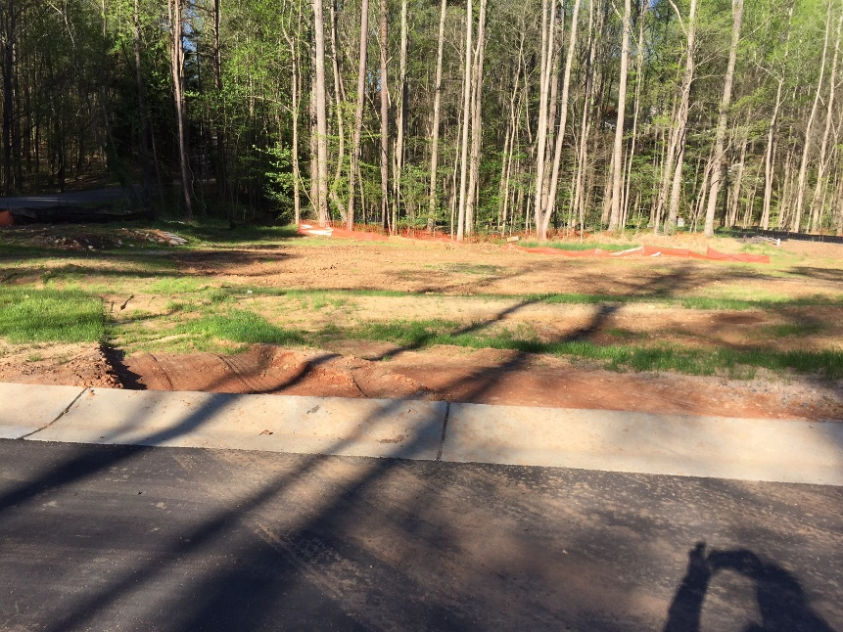
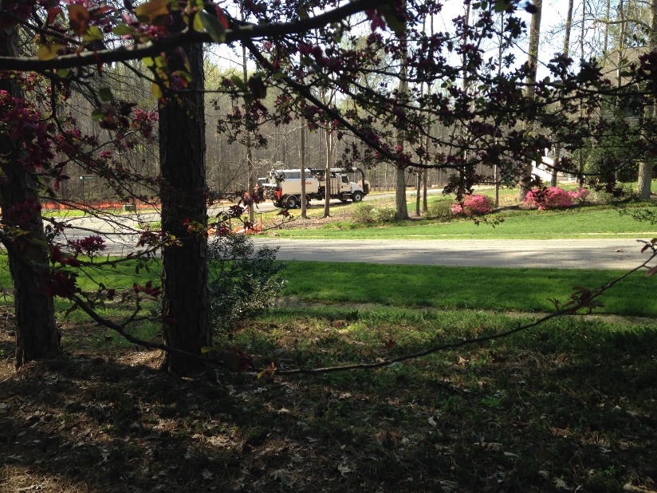
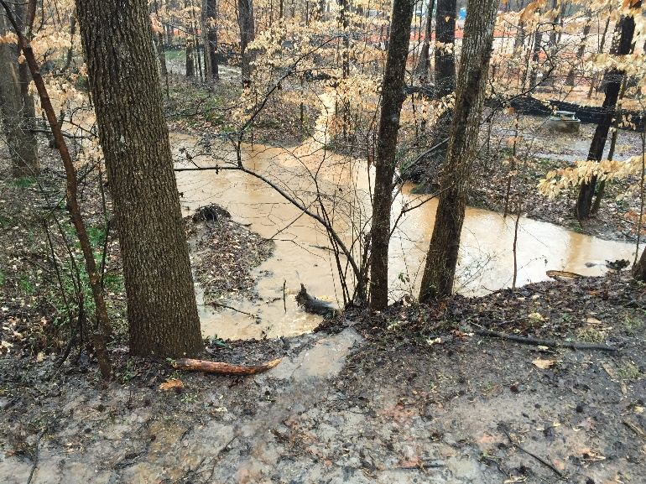
Figure 3. 3 April 2016
Location of the water dumping; photo taken 10 days after the event. The land had been graded in the meantime.
Hare Snipe runs along the line of trees in the background.
Figure 4. 24 March 2016
Vacall truck that dumped water on land adjacent to Duckview Court. Dumped water flowed unimpeded into Hare Snipe Creek.
Figure 4. 3 Feb 2016 Picture taken during a rain event a month before the dumping. This gap under the silt fence was still present on 24 March 2016 when the water was dumped allowing the dumped water to proceed unimpeded into Hare Snipe Creek. The gap has been blocked since the dumping.

